Slide 1


2024 HCA Single-Cell Omics in-person Computational and Experimental Design Workshop Single-cell multiomics: immune repertoire
June 24-28, 2024
Bangkok, Thailand

Slide 2
Computational track schedule
 | Beginner | Advanced
Monday | Preprocessing/QC | Data integration/cell type annotation/DE
Tuesday | Clustering/DE/data integration/cell type annotation | multi-omics/DA
Wednesday | TCR/BCR/CITE-Seq
Thursday | Trajectory inference/cell-cell communication
Friday | project/presentation

Slide 3
BCR biology and single-cell detection using 10x genomics
Computational analysis of single-cell BCR data
Other single-cell multi-modal measurements relevant to immunology

Slide 4
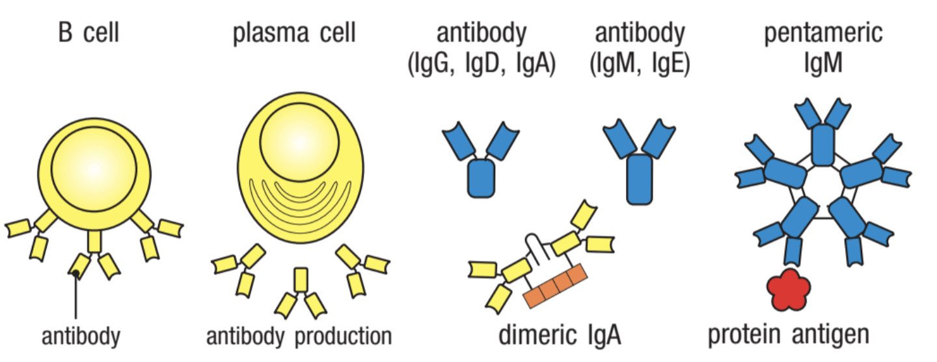
Janeway’s Immunology

Slide 5
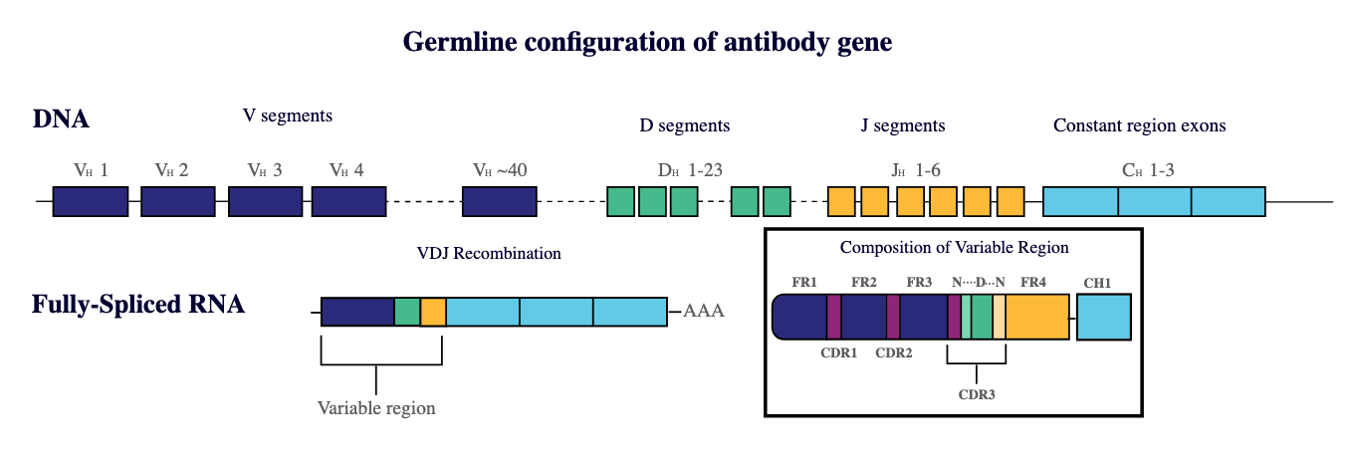
Diversity of antibody genes
iRepertoire Inc.

Slide 6
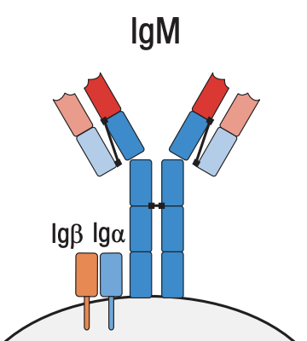
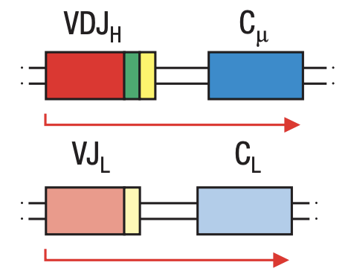
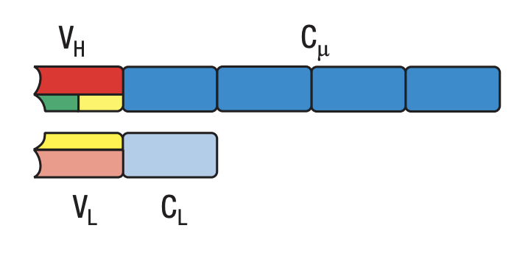
From gene to protein for the B cell receptor
Janeway’s Immunology

Slide 7
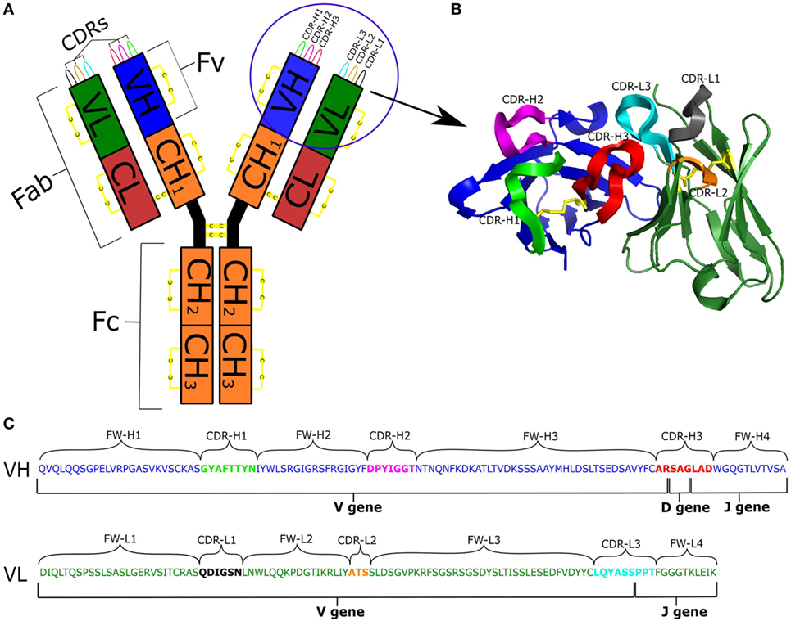
From gene to protein for the B cell receptor
Kovaltsuck 2017

Slide 8
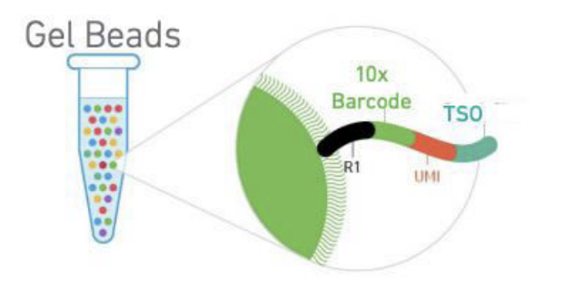
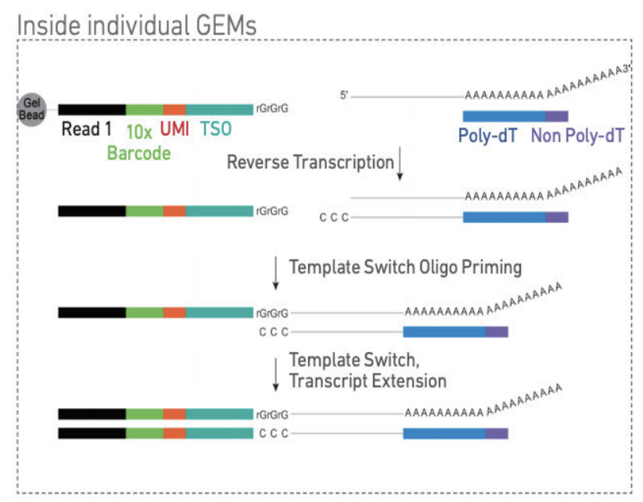
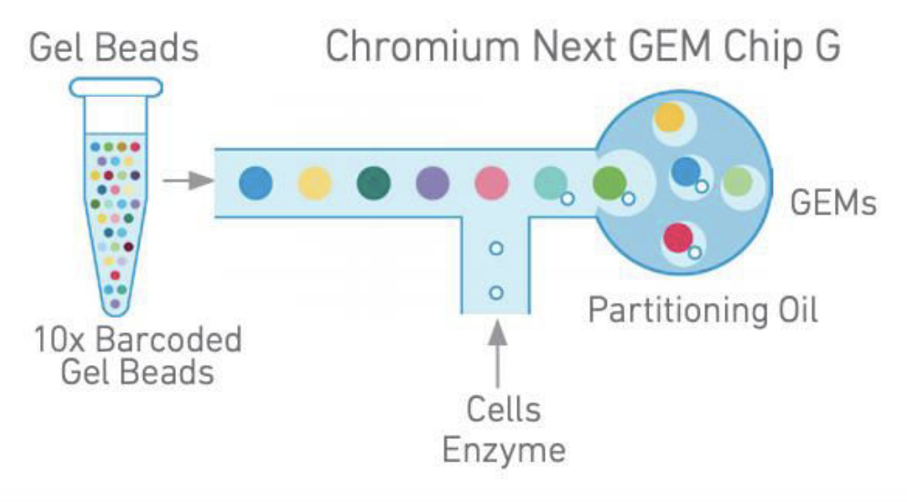
Single-cell BCR sequencing with 10x genomics
10x genomics

Slide 9
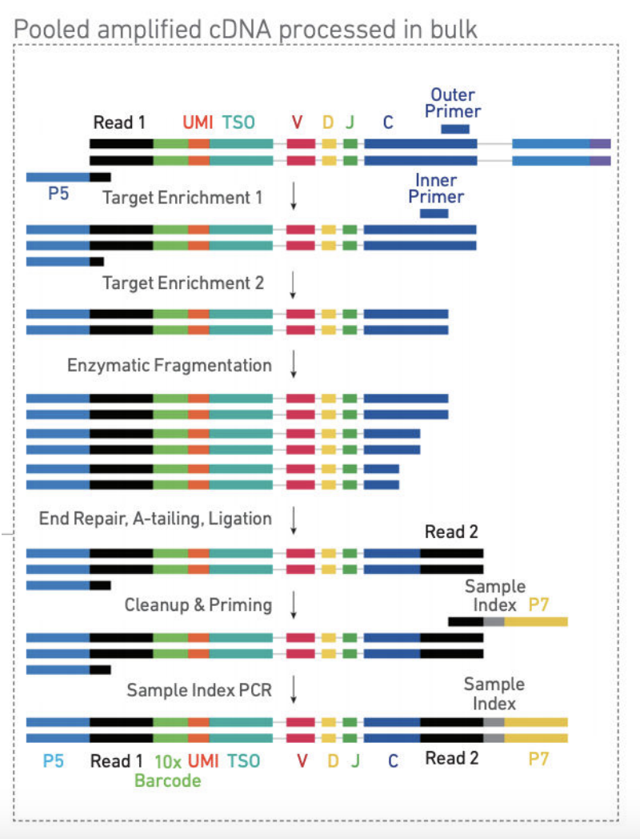
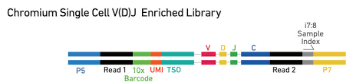
Single-cell BCR sequencing with 10x genomics
10x genomics

Slide 10
BCR biology and single-cell detection using 10x genomics
Computational analysis of single-cell BCR data
Other single-cell multi-modal measurements relevant to immunology

Slide 11
Single-cell BCR sequencing with 10x genomics
10x genomics

Slide 12
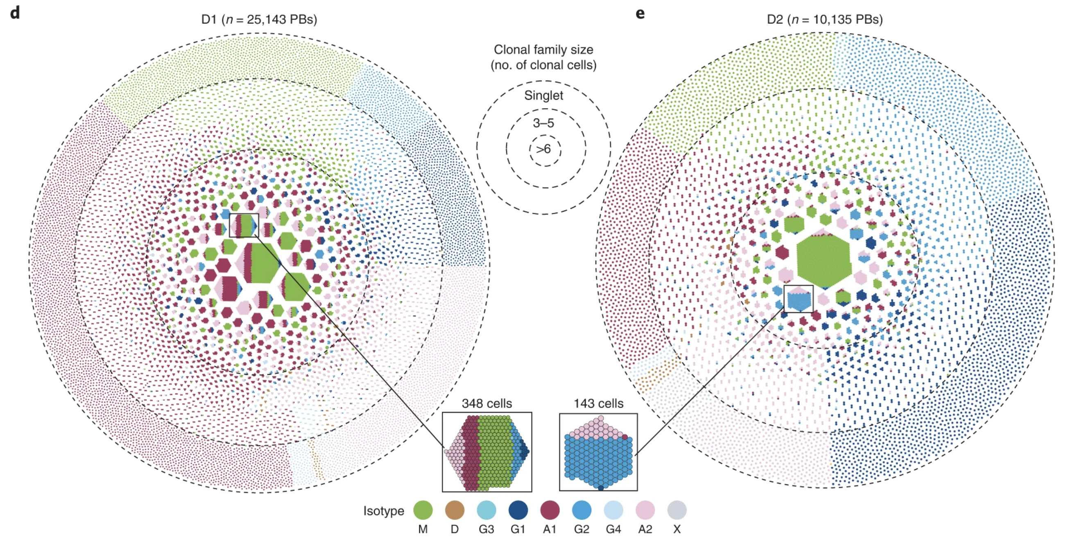
Single-cell BCR-seq to analyze the immune repertoire
Phad 2022

Slide 13
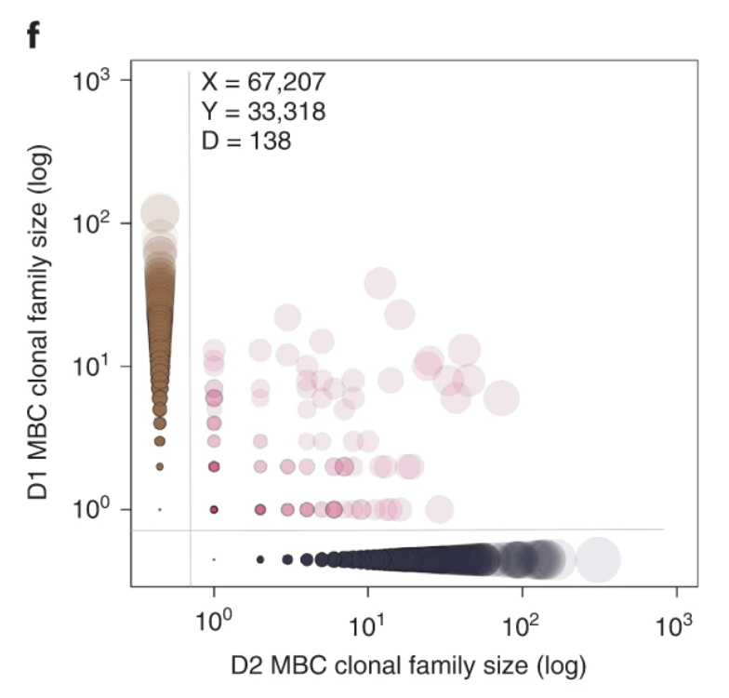
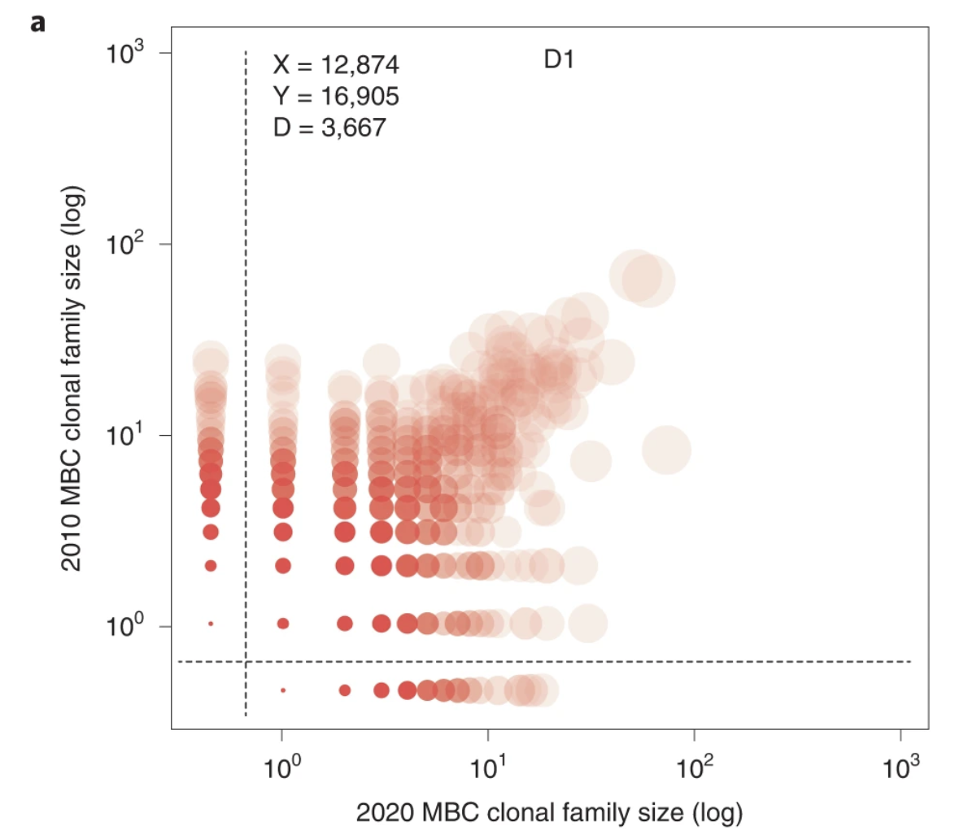
How does the immune repertoire compare between samples?
Large differences between individuals
Small differences across time (for one individual)
Phad 2022

Slide 14
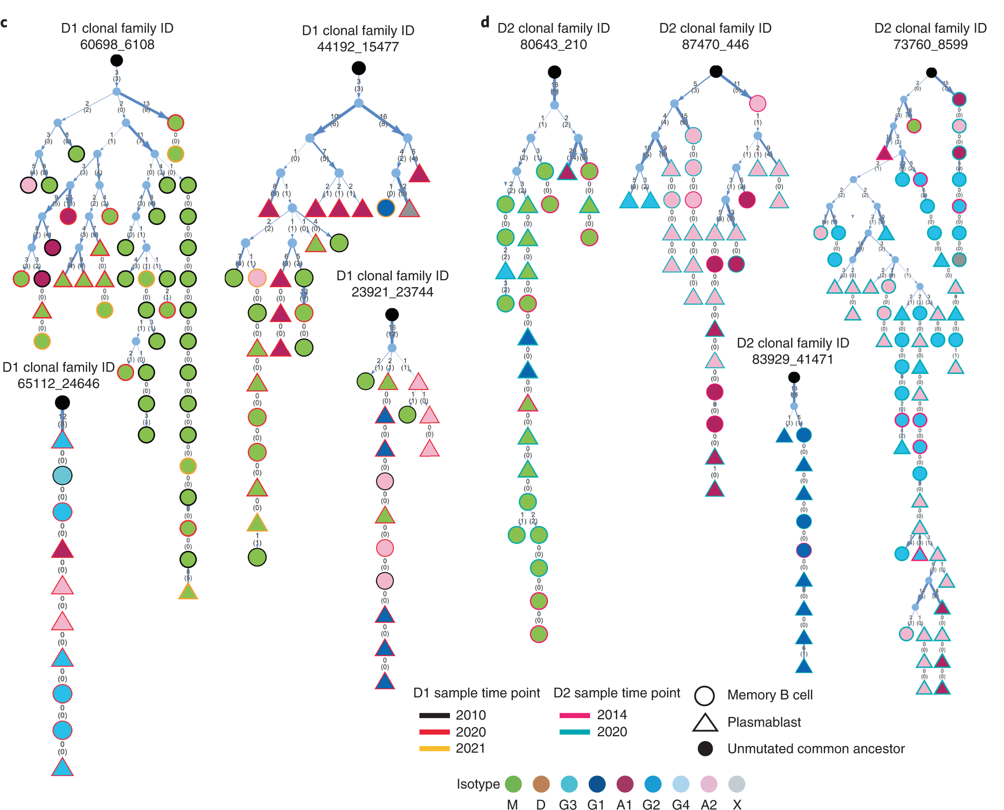
Inferring clonal relationships across cell types
Phad 2022

Slide 15



Several software tools exist for single-cell BCR analysis
R
R
python

Slide 16
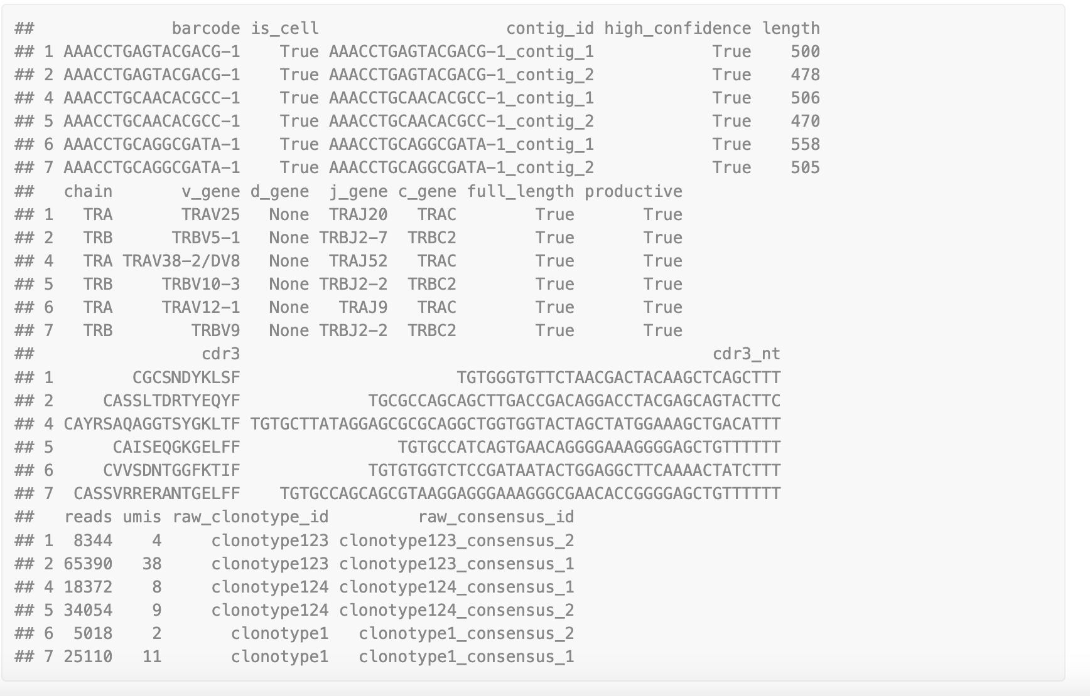
Interacting with scTCR/BCR-seq data in scRepertoire
List of contigs

Slide 17
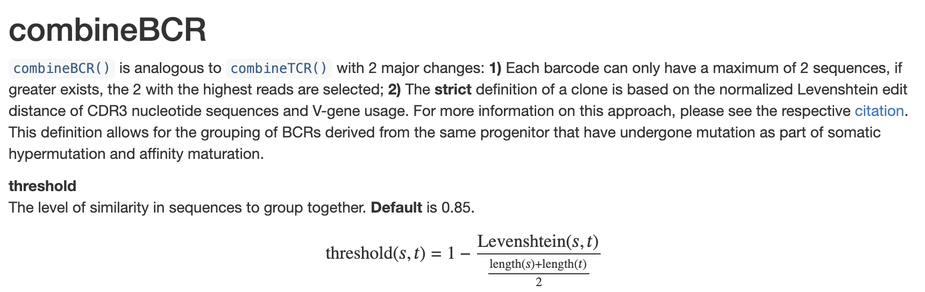
Next: combine contigs into clones
This step can be done a few days, here is how scRepertoire does it:

Slide 18
BCR biology and single-cell detection using 10x genomics
Computational analysis of single-cell BCR data
Other single-cell multi-modal measurements relevant to immunology

Slide 19
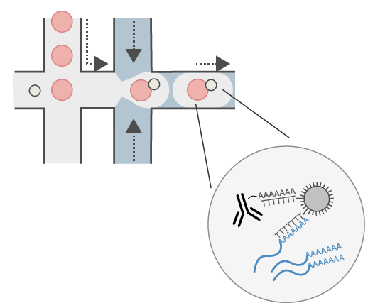
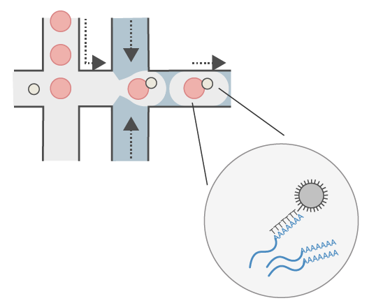
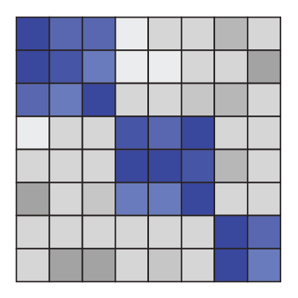
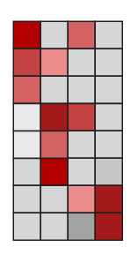
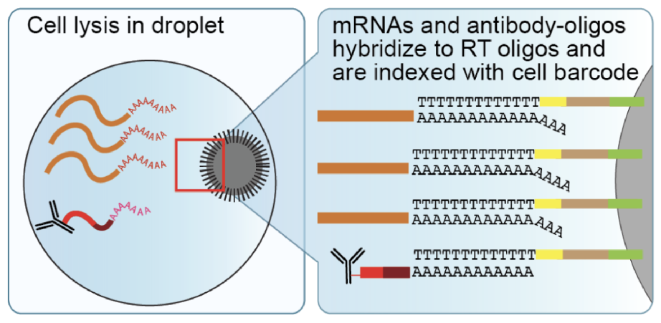
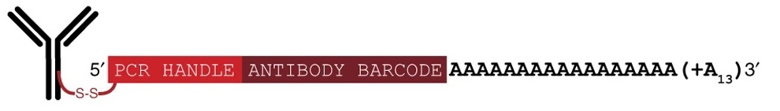
Simultaneous sequencing of proteins and RNA
Genes
Proteins
Cells
CITE-seq, REAP-seq
Stoeckius et al. 2017
Peterson et al. 2017
Poly-A tag on antibodies and mRNA captured together
Hattie Chung (Yale University)
Stoeckius et al. 2017
Notes:
To achieve this, I turned to a then-novel method, CITE-seq and REAP-seq, which showed that you can build on existing single cell transcriptomics methods to capture protein levels at the same time using DNA-barcoded antibodies.
But these method were only applicable to cell surface protein targets.
We solved several challenges to arrive at intranuclear CITE-seq, or inCITE-seq. I will describe how we adapted DNA-barcoded antibodies to measure intranuclear protein targets in a method called intranuclear CITE-seq, or inCITE-seq by overcoming key experimental challenges, and how we used this data to study how gene expression patterns genome-wide are impacted by regulatory proteins.

Slide 20
Data transformation
RNA matrix (n x g)
Protein matrix (n x p)
UMIs | Gene A | Gene B | Gene C
Cell 1 | 0 | 0 | 2
Cell 2 | 1 | 1 | 0
Cell 3 | 0 | 1 | 0
UMIs | Prot 1 | Prot 2 | Prot 3 | …
Cell 1 | 28 | 243 | 85
Cell 2 | 15 | 453 | 119
Cell 3 | 32 | 378 | 52
Standard single-cell processing; log(1+p)
Centered log ratios (CLRs)
Hattie Chung (Yale University)
Notes:
We get a matrix for each cell, where we get gene counts and protein counts
NO ZERO INFLATION REFERENCE UMIs FOR PROTEINS!!!
Gene counts are processed according to standard scRNA-seq protocols
Protein counts are scaled to the centered log ratio, which is a metric used to quantify relative abundances in compositional data. We divide each protein count by the geometric mean within each batch.

Slide 21
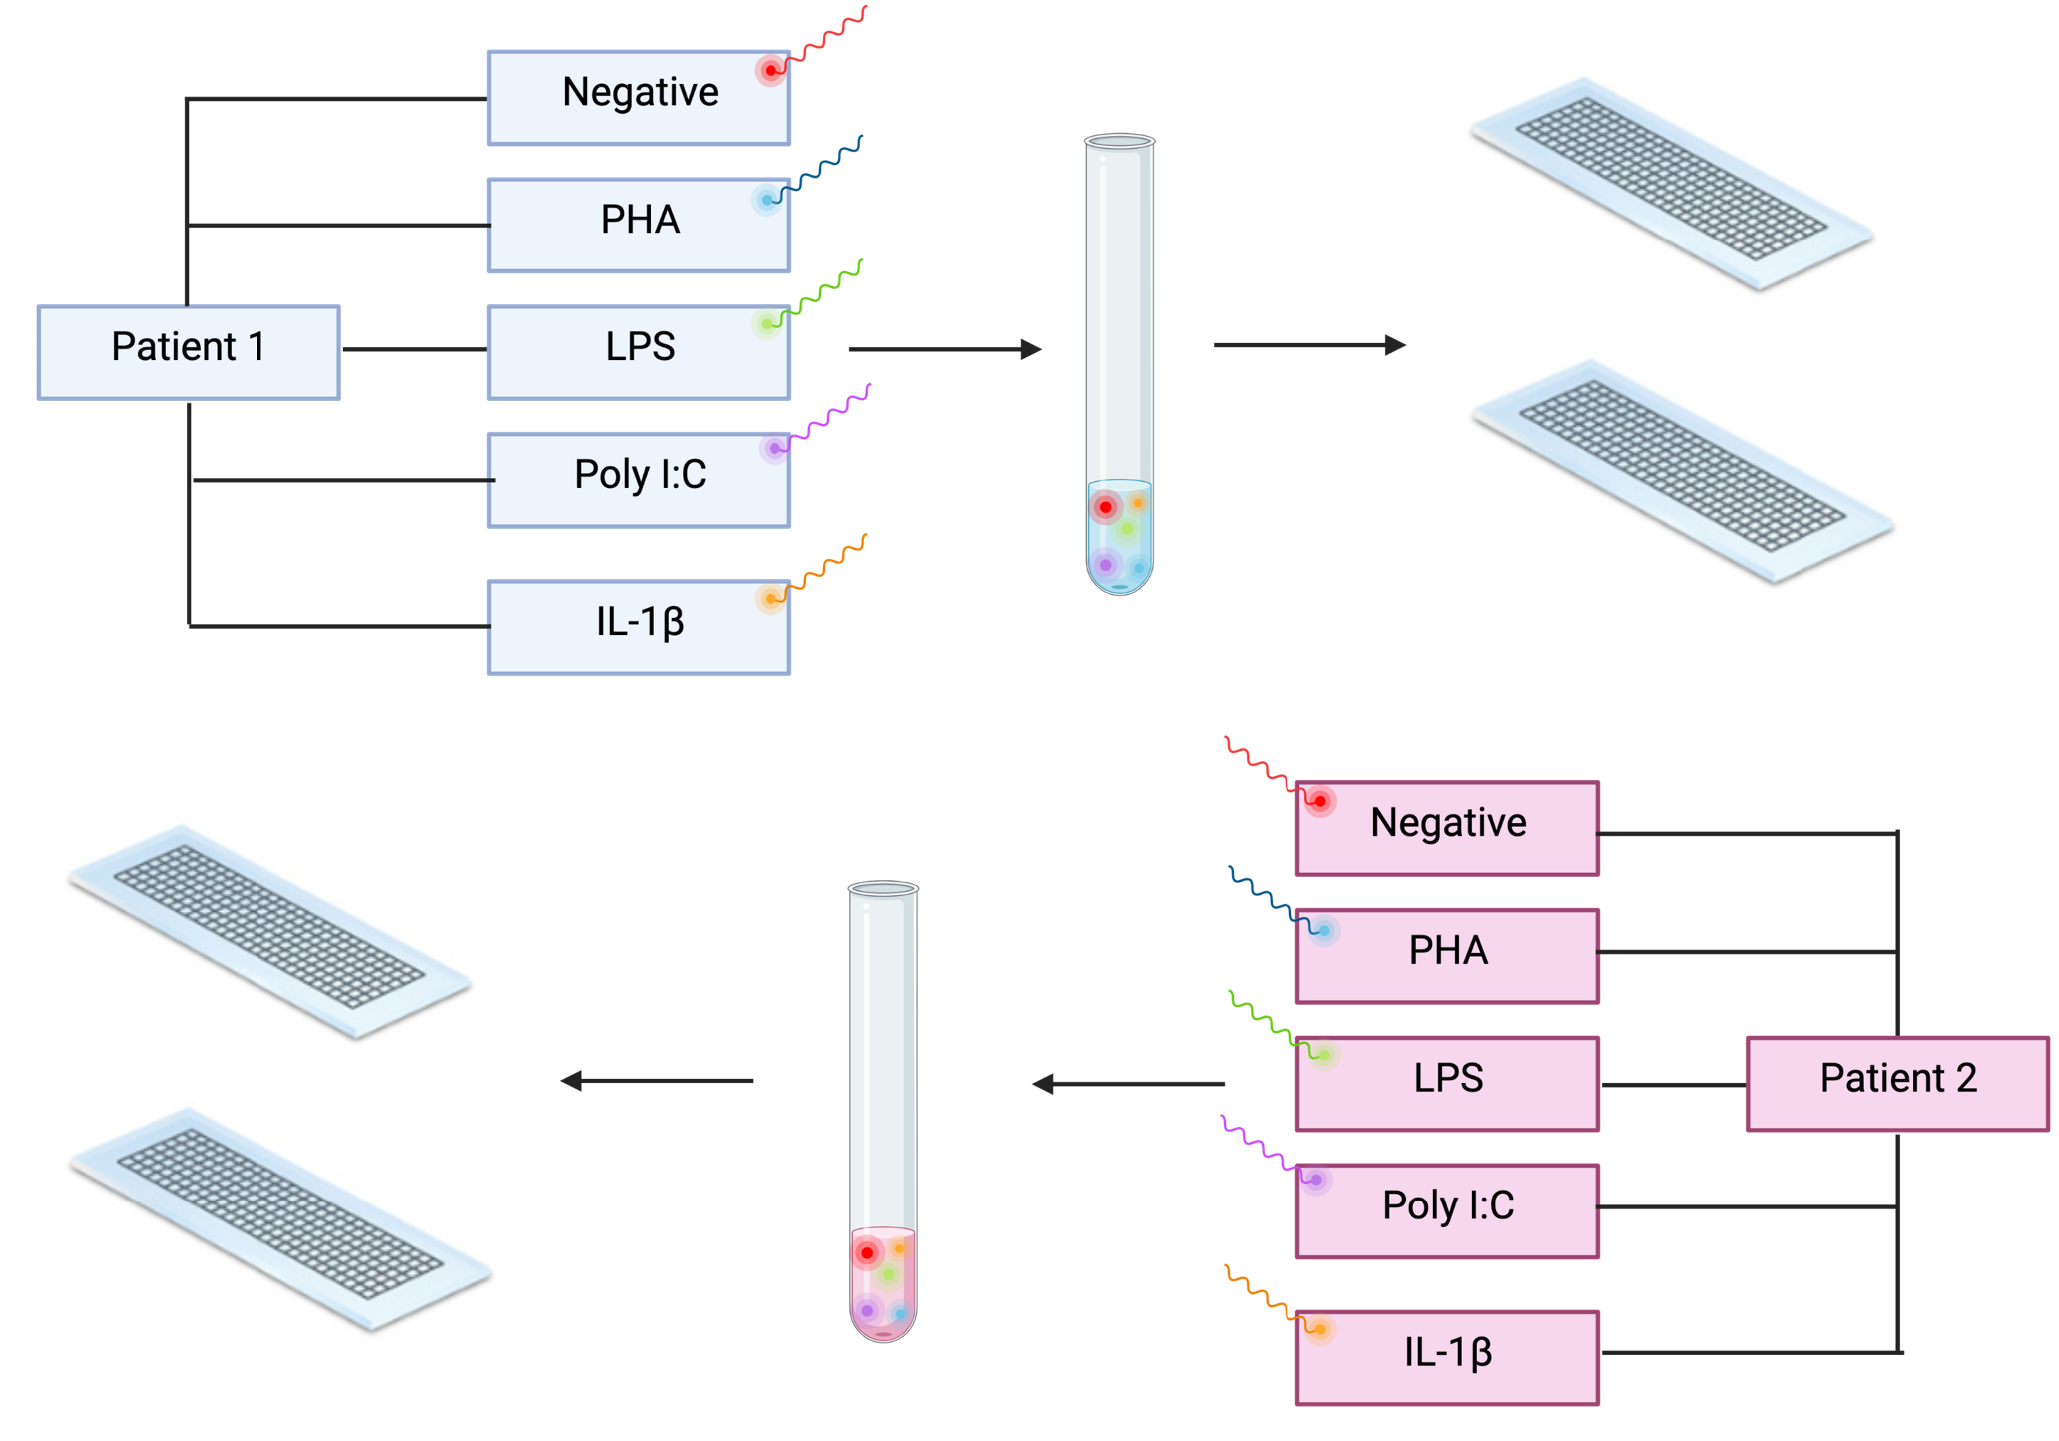

Antibody Multiplexing/Hashing

Slide 22
How do we know what the T cell is binding?

Slide 23
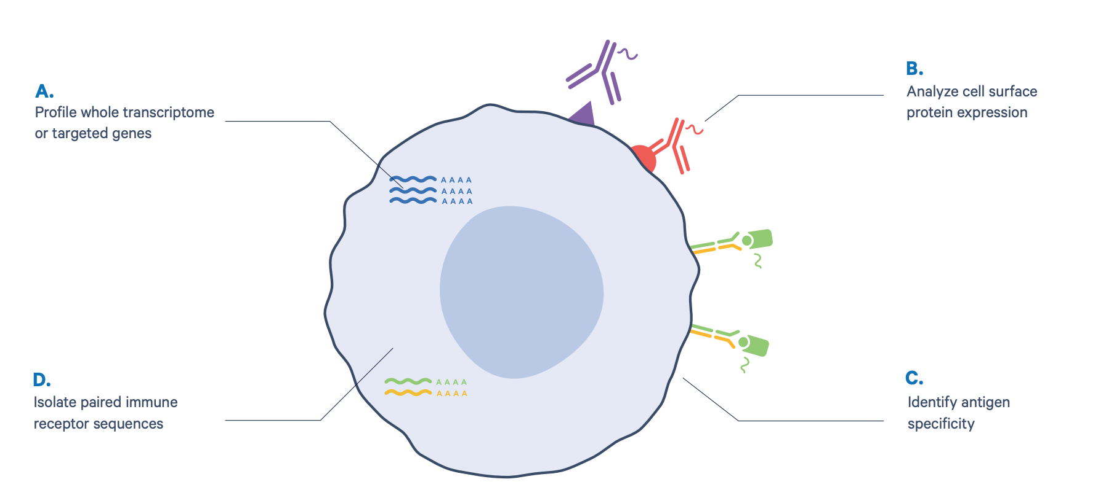

Add peptide-MHC with oligo tag to determine specificity of TCR

Slide 24
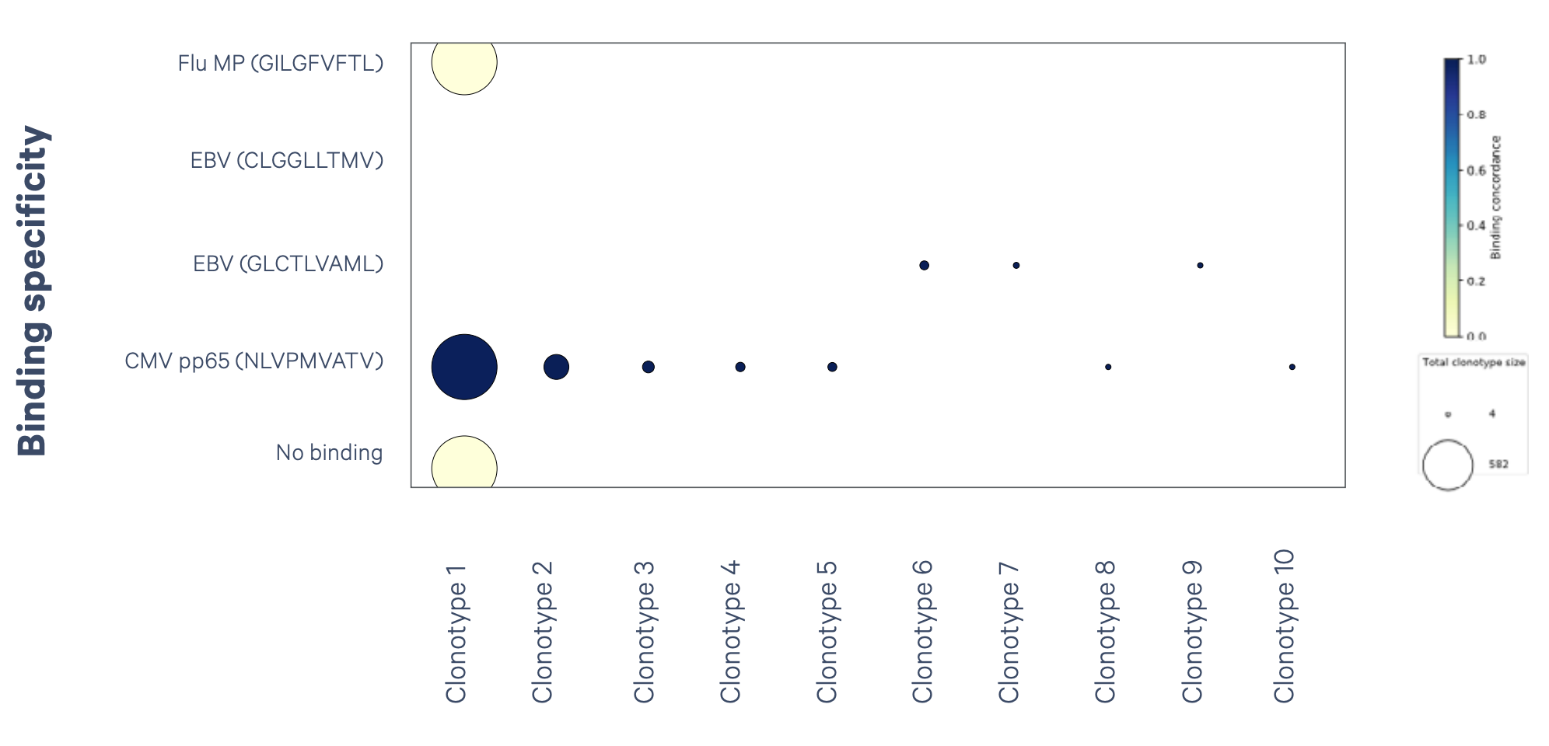
Peptide-MHC mapping tells you what the each TCR will bind and react to

Slide 25
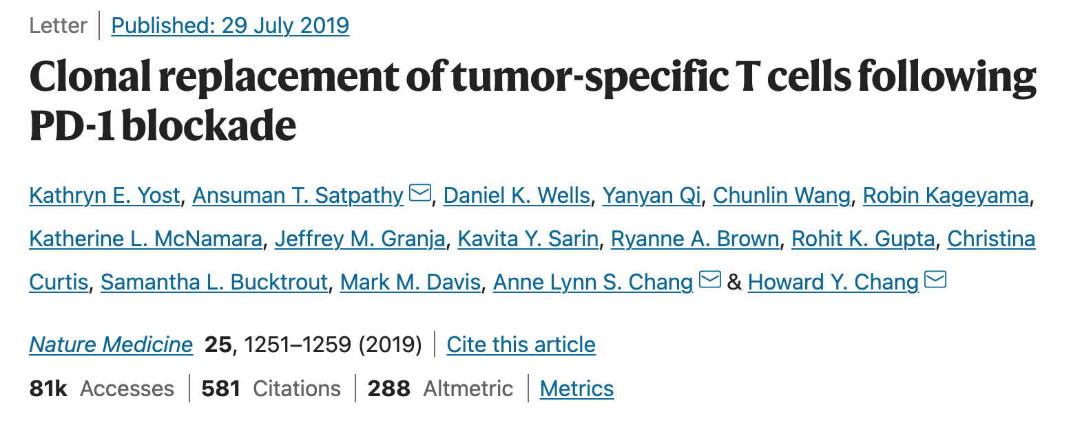
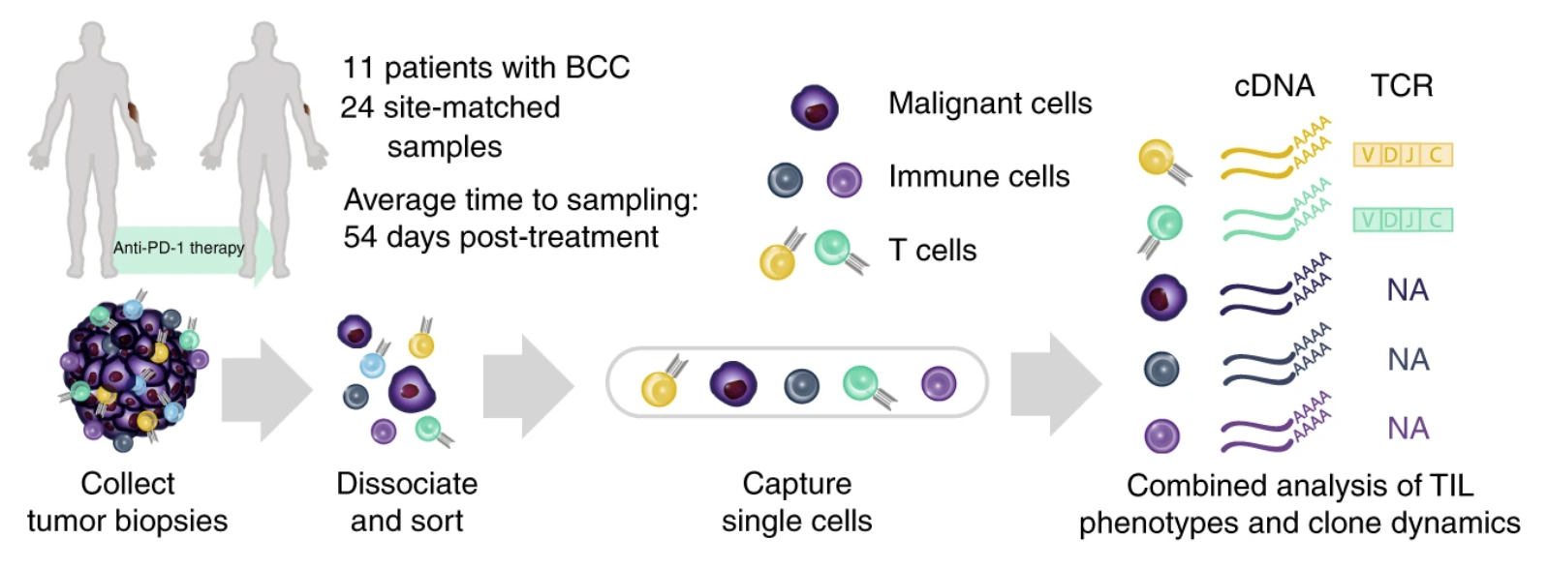

Slide 26
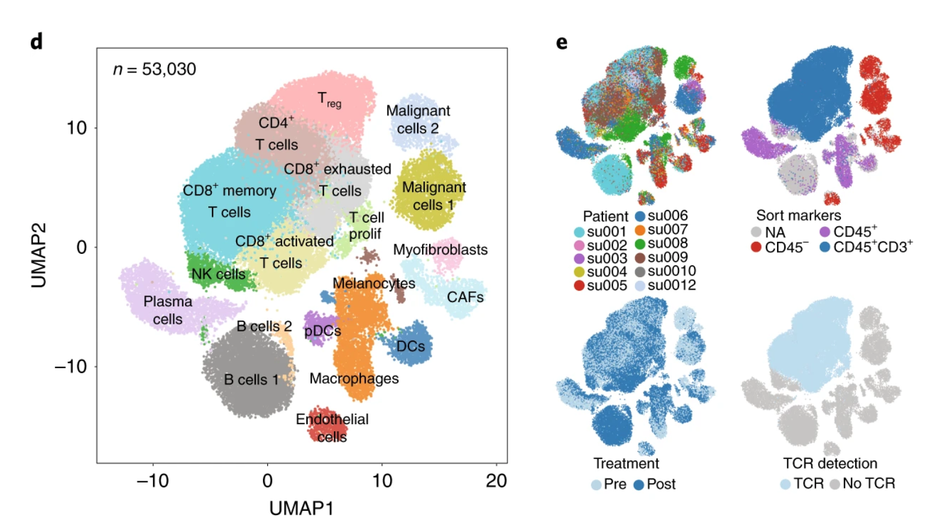
Clustering:
Is there a batch effect from patients?
Is there a batch effect from treatment?
Yost 2019, Nature Medicine

Slide 27
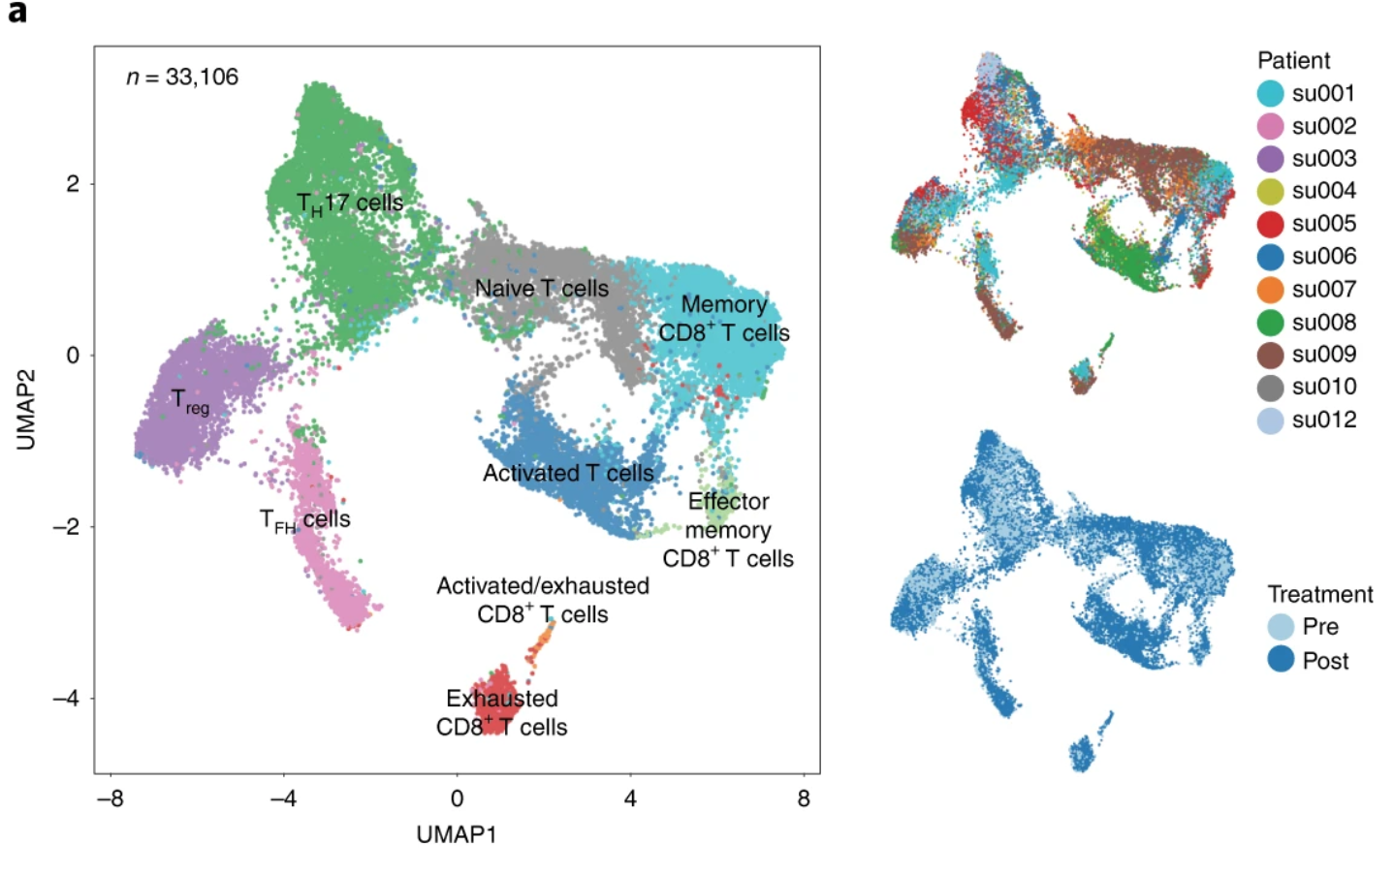
Separation of T cells and re-clustering for more detailed annotation
Yost 2019, Nature Medicine

Slide 28
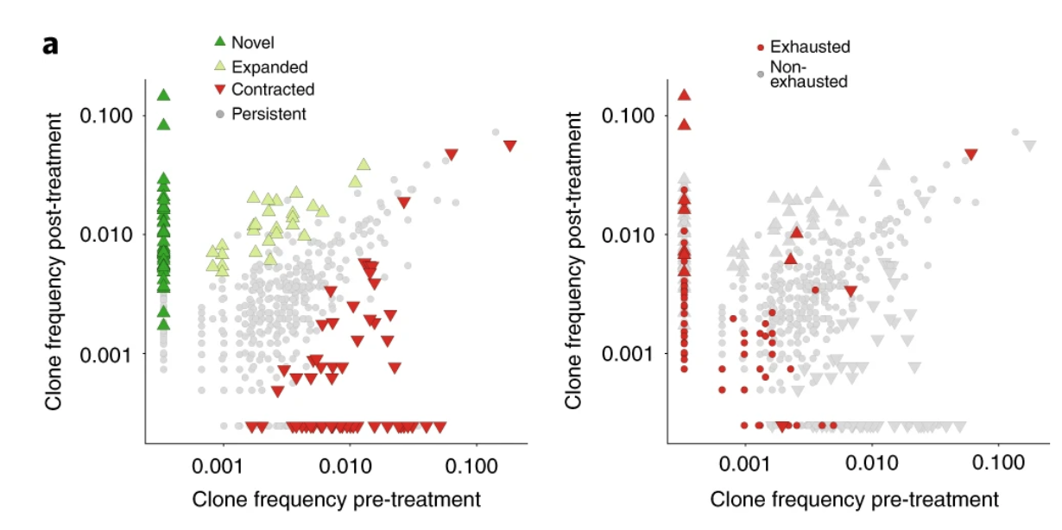
Integration of T cell receptor sequence to determine that new clones arrive in the tumor
Yost 2019, Nature Medicine

